Slide 1

Preventing and Responding to Challenging Behavior in a PBIS Framework
Everett School District
Maggie Schulze Ph.D., BCBA-D
www.soundsupportsk12.com

Slide 2
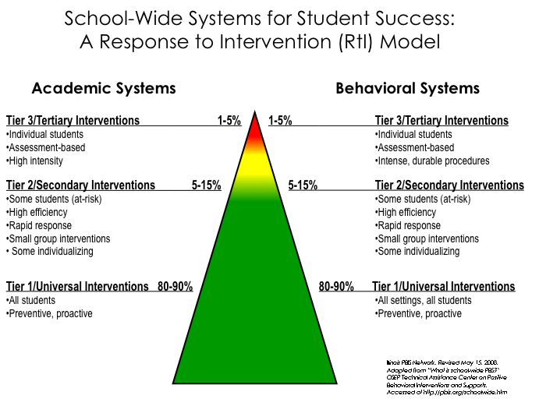
Notes:
2

Slide 3
The district is using the Multi-Tiered System of Support (MTSS) to help schools develop a continuum of supports for every EPS student.
Everett Public Schools Systems of Support

Slide 4
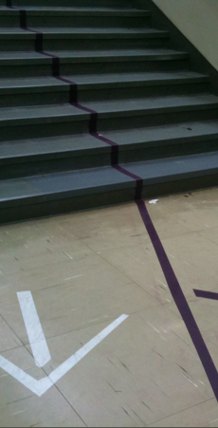
Prevention is Critical
Expectations are clearly defined
  Taught and re-taught
  Visual cues to support
  Pre-correction used
Environment is predictable and consistent
Rules, routines, procedures established

Slide 6
Consistently implemented
Teach needed behaviors
Practiced and reinforced
Series of steps taught explicitly
Posted clearly
“Do” statements
Routines & Procedures

Slide 8
Teach & Practice Voice Levels for Your Classroom or Non-classroom Settings!

Slide 9
Turn and Talk
Are your expectations and routines clearly defined and taught and do you refer to them consistently?
Are there visual cues to support your expectations?

Slide 10
Acknowledgement Systems and Relationships
Another Piece of Prevention

Slide 11
Acknowledgement Systems
Fosters positive connections and a positive environment
Focuses attention on positive behaviors and effort
Fosters a positive school/classroom climate
Positive reinforcement increases the occurrence of desired behaviors
It’s not about the “stuff,” it’s about the connection
You get more of what you pay attention to!
Notes:
Emphasize relationships there. Piggy bank.

Slide 12
How Do We Deliver Reinforcement?
Frequent (5:1)
Always pair with behavior specific praise (“Nice job using your walking feet in the hallway”)
  Gives specific feedback to the student about why he/she is receiving the reinforcer
Ensure all kids receive positive reinforcement
  This might mean rewarding approximations of behavior for some students
  We are SHAPING behavior for these kids!

Slide 13
The 2X10 Strategy
(Smith & Lambert, 2008)
With many struggling or discouraged students we respond (mirror) their lack of connection or challenges by pulling away ourselves.
Instead try 2 X 10!
  Spend 2 minutes a day for 10 days in a row
  Focus on effective, specific praise, feedback and genuine caring/connection
Improves behavior and student connection to school by 85%
Small, consistent investment = big change

Slide 14

Turn and Talk
How do you currently reinforce your students for following expectations? Do you use the school-wide acknowledgement system?
Is there a student you have in mind who may benefit from the 2 x 10 strategy?
How do you build relationships with your students?
Notes:
245

Slide 15
Responding to Behavior

Slide 16
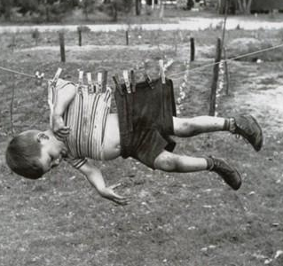
We Don’t Punish Behavior Out of Kids
Punishment is used to try to force compliance. The vast majority of school discipline procedures are forms of punishment that work best with the students who need them the least.
Discipline, unlike punishment, is proactive and begins before there are problems. It means seeing conflict as an opportunity to problem solve. Discipline provides guidance, focuses on prevention, enhances communication, models respect, and embraces natural consequences. It teaches fairness, responsibility, life skills, and problem solving
From: Aiming for Discipline Instead of Punishment by Lori Desautels
Notes:
Consequence is only effective if it changes behavior
Academic vs social approaches

Slide 17
Challenging Behavior Will Occur: How do we respond?
No matter how positive and proactive we are, there still will be some instances of challenging behavior
When responding to behavior we have to ensure:
  We are consistent
    Do we agree on what a minor infraction is? What a major infraction is?
    Do we agree on what defiance or disrespect look like and sound like?
    Do we follow the same protocols to address challenging behavior?
  We have a continuum of interventions that we use in the classroom from least to most intrusive that the scholars are aware of
  We employ effective consequences
    Remember a consequence is only effective if it changes behavior
    Related, respectful, logical consequences that emphasize re-teaching, repair, reintegration

Slide 18
The Secret About Problem Behavior…
Problem behavior is not a “problem” for students!
In fact it is a “solution” for them!
• Behavior happens in contexts, not a vacuum
• Many factors influence problem behaviors
The most important factors are in the IMMEDIATE
context or environment (Simonsen, 2012)

Slide 19
In PBIS We Strive to:
Make Behaviors Ineffective and Inefficient by:
  Restructuring the Environment
  Our Procedures
  Our Responses
It is generally about environmental and adult behavior change and making small changes for big gains.

Slide 20
Quick Error Corrections
Your error corrections should be…
  …contingent: occur closely after the undesired behavior
  …specific: tell learner exactly what they are doing incorrectly and what they should do differently in the future
  …brief: after redirecting back to appropriate behavior, move on

Slide 21
Basic Intervention Steps For
Minor Problem Behaviors
First Focus on Keeping Instruction Going and Assign a Task to Students if Needed
Praise/Acknowledge Students Who Are On-Task
Use Proximity
Clearly Restate the Expectation
Provide Choices to Get on Track
Have Plan for Ongoing Non-compliance
Do Not Make Mountains of Molehills
Remember: You Will Get More of the Behaviors You Pay Attention to…
Notes:
This is an area that it might really be beneficial to model implementation. It is the area teachers have least training and confidence in doing and then end up in power struggles.

Slide 22
For Repeated Challenging Behaviors, Ask Yourself…
Do they understand the expectations?
Are they aware that they are exhibiting the challenging behavior?
Are they able to engage in the expected behavior?
Do they want attention (from you? From peers?)
Do they want to escape a task (because it is too challenging)?
IS THIS A CASE OF WON’T DO OR CAN’T DO?

Slide 23
Teaching and Coaching Behavior (Can’t Do)
Some students do not know how to engage in appropriate behaviors or how to regulate their emotions.
Ways staff can support growth in this area:
Reinforce and coach what students are learning in other places (e.g., in Second Step, in social skill groups).
  “I know you are working on asking for help. I like how you raised your hand.”
  “You are frustrated. Let’s use a coping skill.”
  “You are heading out to recess now. What is the first step in asking to join a game?”
Help students recognize when they are engaging in challenging behaviors and give them replacement behaviors
Model the behavior you want to see
Re-teach in the moment as needed

Slide 24

Teaching Behavior
Repetition is key to learning new skills:
  For a child to learn something new, it needs to be repeated on average of 8 times
  For a child to unlearn an old behavior and replace with a new behavior, the new behavior must be repeated on average 28 times (Wong, H)

Slide 25
Functions of Behavior (Won’t Do)

Slide 26
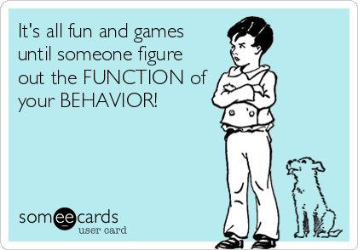
What is the Function?

Slide 27
Sometimes obvious – runs out of the classroom
Less obvious – argues or talk outs about assignments
Often accessing time-outs or ISS or OSS
Function of the Behavior
Escape Motivated Behavior
Attempt to avoid a task, demand, or person
Obtain Tangible Thing Behavior
Attempt to get a tangible object or a specific agenda
Engaging in Sensory Stimulation Behavior
Student is motivated by looks good, sounds good, taste good, or feels good behaviors.
Attention Seeking Behaviors
Student is trying to gain attention from adults or peers
Often belligerent
Loud
Interrupts adults
Also can be a positive – being a teacher helper
Humming loudly
Must stand up and walk around
Chewing on things
Sensory behaviors often become disruptive
Peers occasionally see these behaviors as weird
Wants what he wants when he wants it
Inflexible, self-centered
Some history of abuse and neglect
Low frustration tolerance
Operates with the assumption that must take to get needs met
Rappaport, N. & Minahan, J. (2013)
Durand, V.M. (1990)

Slide 28
Functions of Behavior
Antecedent | Behavior | Consequence
1. Teacher asks student to complete the assignment | 1. Student rips up paper | 1. Teacher sends student to “Time Out”
2. Phone rings, parent puts child down to answer the phone. | 2. Child starts crying | 2. Parent puts phone down, and cradles child saying, “shhhh”
3. Teacher tells student he/she has to wait | 3. Student hits his/her teacher | 3. Teacher brings student outside classroom and explains hitting is wrong.
4. Teacher walks away from one student to help another. | 4. Student makes disruptive noises. | 4. Teacher returns to student to reprimand him.
5. Parent tells child that they can’t have the item he/she requested. | 5. Child screams and jumps up and down. | 5. Parent gives the item to calm them down.
Escape:
Task or activity
Obtain:
Attention
Obtain:
Attention
Obtain:
Attention
Obtain: tangible
Notes:
So why does this matter? If we all understand the purpose of a behavior, we understand why and how to intervene. If a student blurts out repeatedly in class and we know the function is attention, that helps us figure out what we need to do to stop the behavior. Stop giving him attention and helping him find another behavior to get attention that is more acceptable.

Slide 29
Why Do We Care About Functions of Behavior?
Helps us understand the behavior (the WHY behind it)
Helps us collect data on the behavior for students who are approaching Tiers 2 and 3
Helps us respond to the behavior more effectively
Helps us avoid taking the behavior personally
Become curious rather than furious!

Slide 30
Strategies to Address Low-Level Behaviors in the Classroom Based on Function

Slide 31
Strategies For Addressing Functions Of Behavior: Attention Seeking
For students seeking attention:
Planned ignoring for off-task behaviors (but providing attention as soon as students are on-task)
Provide more positive attention before challenging behaviors occur
Teach the student how to get attention in a positive way (e.g., raising her hand)
Verbiage:
Praise a nearby peer who is on-task while ignoring target student: “I like how Julie is focused on her math with a quiet mouth and safe body.”
“Johnny, I will give you attention when I see you focused on your math assignment.” Provide praise and attention when you see that.

Slide 32
Strategies For Addressing Functions Of Behavior: Escape
For students seeking escape:
Don’t kick them out/send them to time-out
Use a break system (Teach them it explicitly)
Expectation is to re-engage after break is over
Reinforce appropriate breaks
Verbiage
“This might be a good time to take a break. I see you are in the Yellow Zone”
Consider how task demand is presented
“Great work taking a break to self-manage”

Slide 33
Strategies For Addressing Functions Of Behavior: Obtain own Agenda
For students seeking to obtain their own agenda:
Provide choices whenever possible
Support use of self-regulation strategies to increase frustration tolerance
Be mindful of conflict cycles/power struggles
Verbiage:
“You have the choice to sit at your desk or on the carpet. When I see you in the group you will be earning tickets again.”
“You have a choice to be in the commons or the library right now. I look forward to giving you Hawks Cash when I see you following expectations.”

Slide 34
Strategies for Addressing Functions of Behavior: Sensory
  Provide movement breaks
    Delivering something to the office
    Getting a drink of water
    Moving books/boxes
    Cleaning/chores in the classroom
In class supports
  Wiggle seats
  Chair bands
  Stools
  Collaborate with your Occupational Therapist

Slide 35
Related, Respectful, Logical Consequences
Name-calling: Have the student create a book of positive affirmations for the class, or have them create a list of “kind words” and teach them to a younger class.
Low-level physical aggression (pushing, kicking, hitting): Some consequences could include giving the student a new learning space in the room or a new spot in line, or they could be tasked with performing an act of kindness or service for the hurt person.
Inappropriate language: An older student could research the words they used and report to you on why they’re not school words; younger students could try to write out what they were trying to convey using school-friendly language or drawings.
Incomplete assignments: Have a one-on-one discussion to convey what this behavior communicates to you. Ask if something has changed at home or school, or if the student doesn’t understand what is required. Make a plan with the student and possibly a parent for making up the work that has been missed. And consider assigning a student mentor to help the student.
From: Aiming for Discipline Instead of Punishment by Lori Desautels

Slide 36
Turn and Talk
Think about the challenging behaviors you encounter consistently (can be whole class, a small group of students, individual student)
Consider if these behaviors are “Can’t Do” or “Won’t Do”
Consider functions of behavior
How might you address these behaviors based on what we’ve discussed?
What are some logical consequences you can establish in your classroom to respond to challenging behavior?

Slide 37
Putting It All Together in the Classroom

Slide 38
Is Tier One in Place in the Classrooms?
Classroom-wide Positive Expectations Taught, Encouraged & Reinforced And Match School-wide Expectations
Teaching Classroom Routines
Ratio Of 4-5 Positive To 1 Negative Adult-student Interaction
Maximum Structure and Predictability
Frequent and Varied Opportunities
Consistent Responses to Challenging Behavior Including:
  Redirections For Minor, Infrequent Behavior Errors
  Frequent Pre-corrections For Chronic Errors

Slide 39
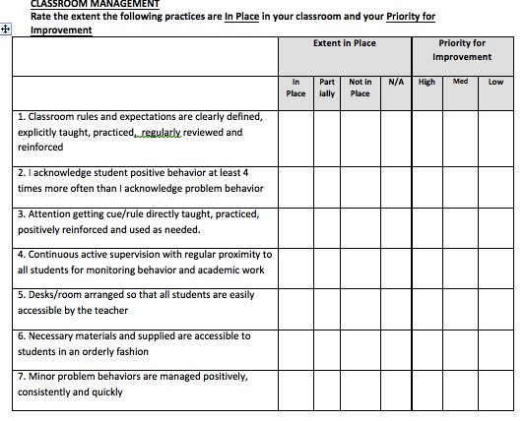
Classroom Management
Self-Assessment
15 minutes
Complete the Classroom Management Self Assessment Checklist
What are your strengths? Areas to develop?
Pick Two Items To Focus on and Set a Goal

Slide 40
RESOURCE
www.Pbisworld.com

Slide 41

Final Questions
maggie.schulze@gmail.com

Slide 42
Acknowledgement
In addition to sources cited throughout, this presentation was created with contributions and materials from:
Bella Bikowsky, Ph.D.
Lisa Hoyt, Ph.D.
Lori Lynass, Ed.D.
Bridget Walker, Ph.D.
Note: All materials and content provided are property of the presenters. All Rights Reserved. Request written permission for use outside your classroom.

